Slide 1
TORCS Racing Computational Intelligence
A. Parnia and M.A. Jayaraj
(Grop 39)

Slide 2
Agenda
What Controllers were used?
How we measured their Accuracy?
What Fitness Function was used?
What we did to improve performance?
What is the final outcome?

Slide 3
Controllers
Neural Networks
Recurrent Neural Network (Pyrenn) using RTRL
Echo State Network (Pyesn)
Evolutionary Computing
NEAT and HyperNEAT
Swarm Behaviour
Emergent Collective Behaviour

Slide 4
Accuracy Measure
Neural Networks
80% training and 20% spliting, measure of MSE after 100 generations
Evolutionary Computing
Evolved a Recurrent NN from scratch
Fitness function = Maximum Distance Travelled
Constrain = Car should stay within track edge
Tested the network on 20% of test data to visualize the output
Swarm Behaviour
No measure on accuracy, but only created an Emergent collective behaviour

Slide 5
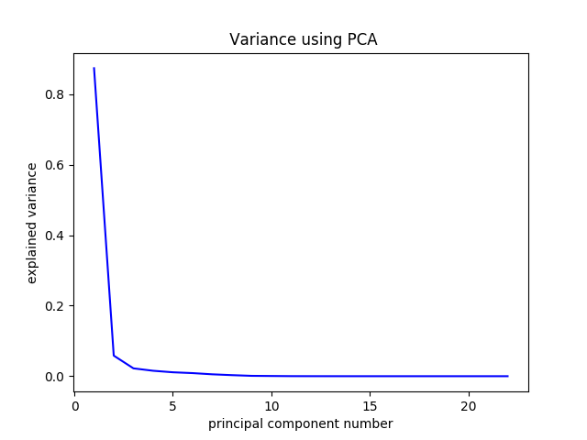
Performance Improvement
Feature Extraction
PCA
New features from Sensor 8,9 and 10
Activation Functions
Tanh, Sigmoid, clamped and Sin
Sin performed the best for our network

Slide 6
Performance Improvement
Normalization of Inputs
Angle = Angle / ∏
Speed = (max(0, min(Speed, 200)) / 100) -1
D_center = max(min(D_center / 2, 1), -1)
D_Edge= ((D_Edge + 1)/100.5)-1

Slide 7
Fitness Function
Constraint Opmimization problem
Maximize the fitness function
Fitness = Distance travelled in a lap
Constrain = Stay within the track edges

Slide 8
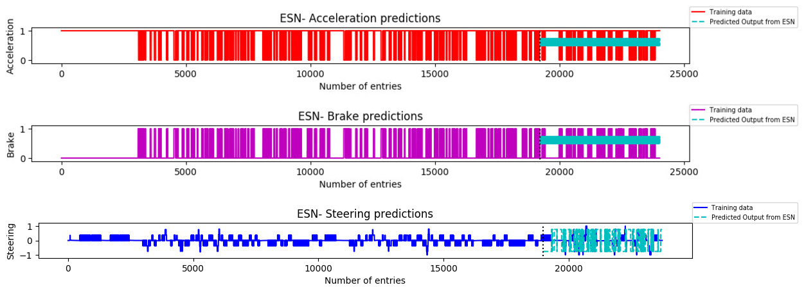
Results
Predictions of ESN

Slide 9
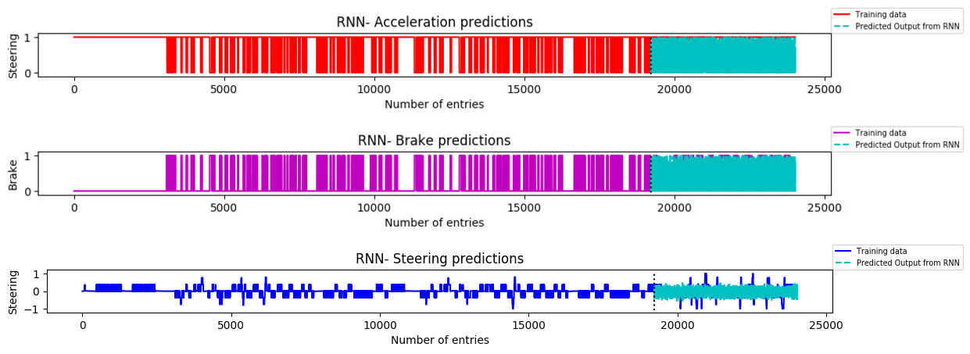
Results
Predictions of RNN

Slide 10
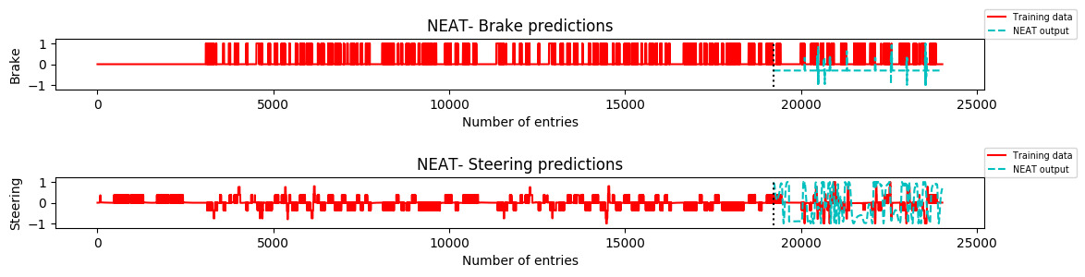
Results
Predictions from NEAT

Slide 11
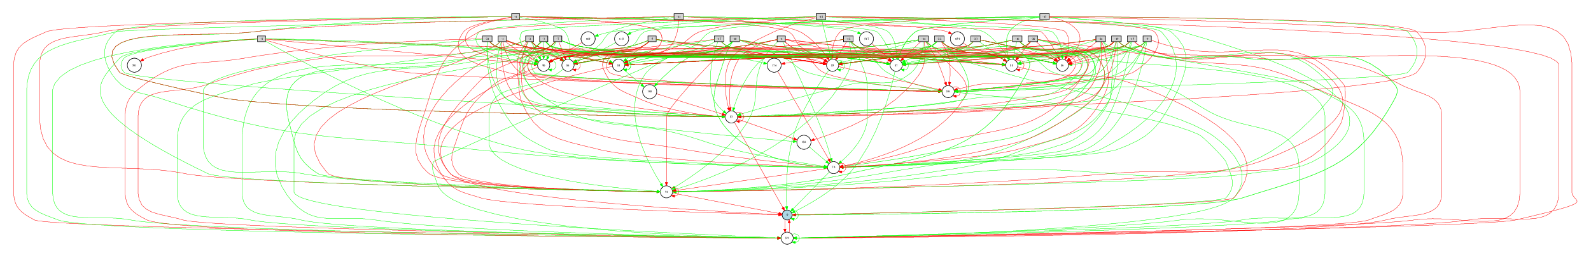
Results
NEAT- Steering Topology

Slide 12
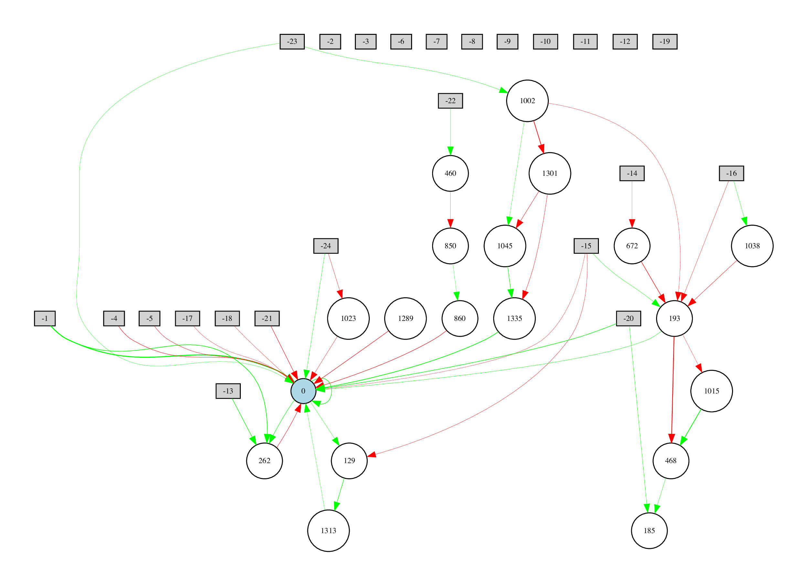
Results
NEAT- Brake Topology

Slide 13
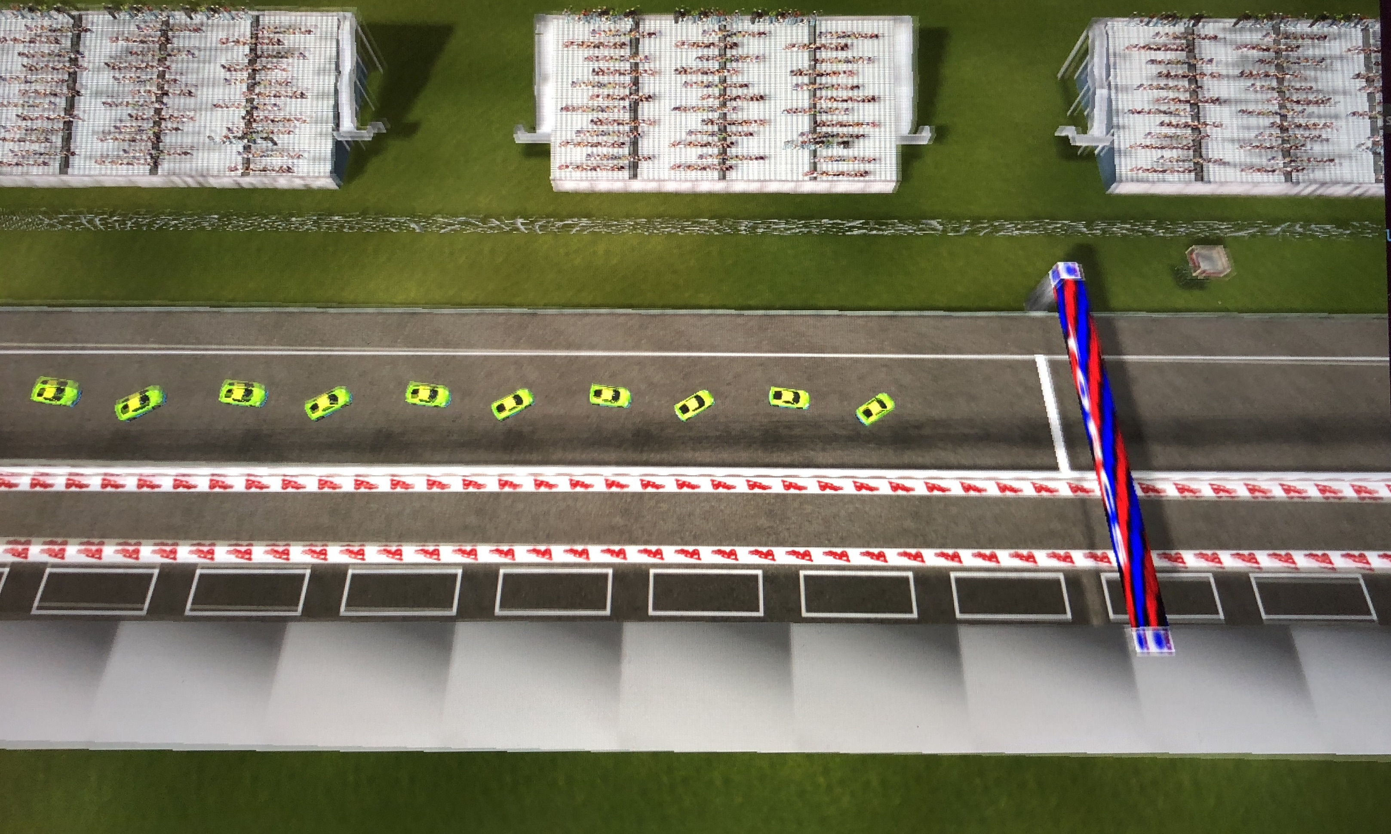
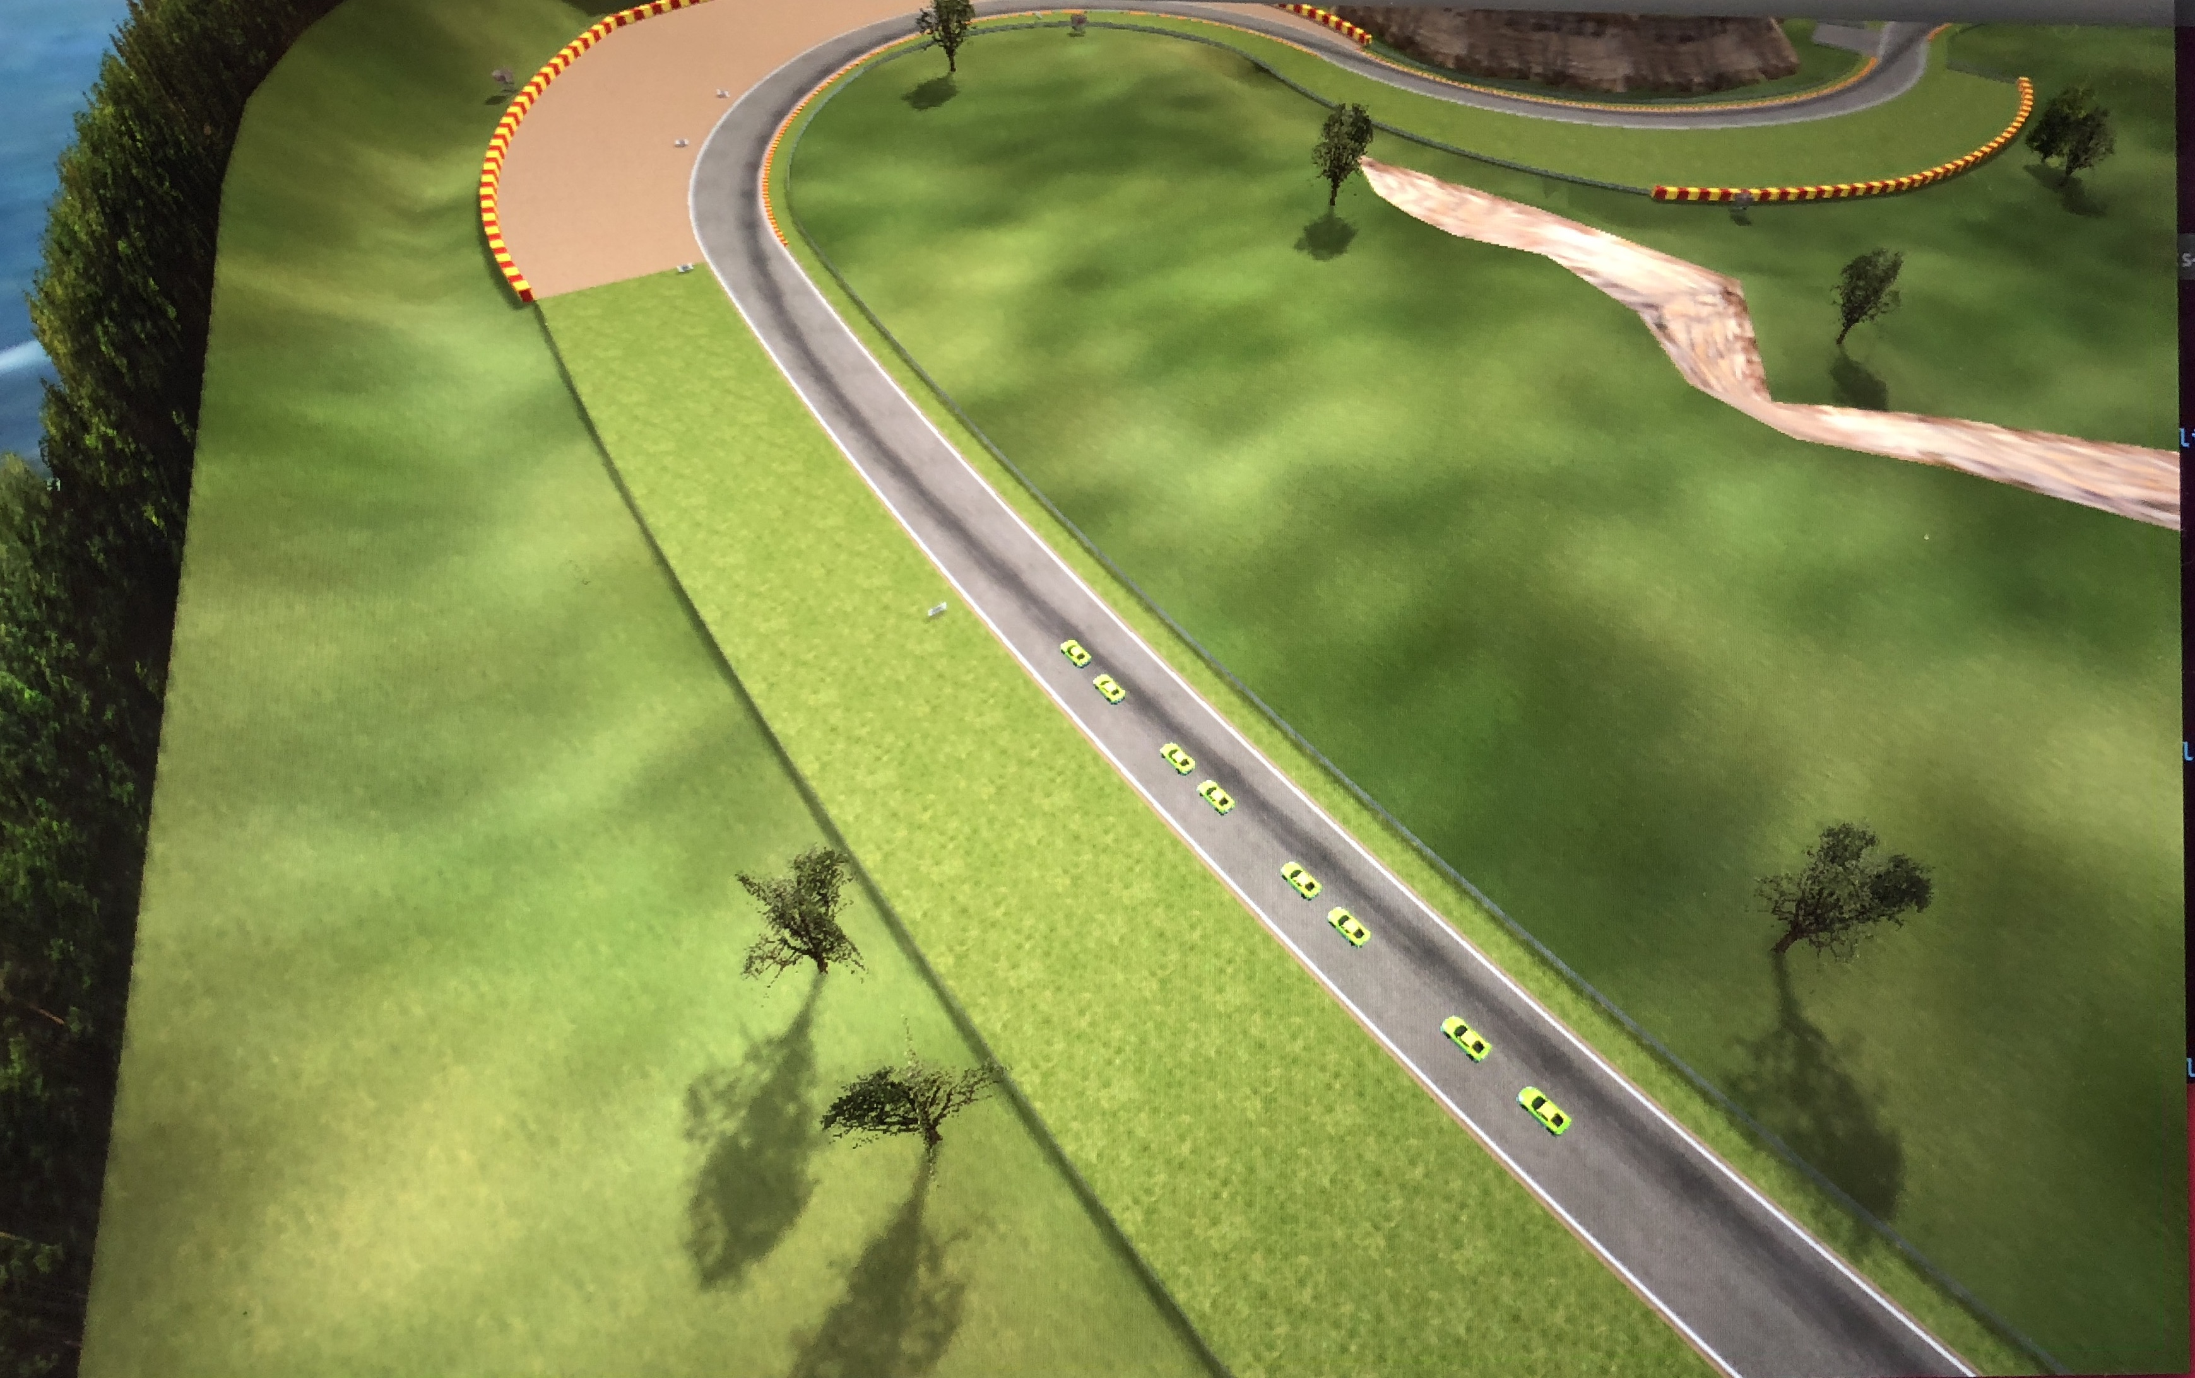
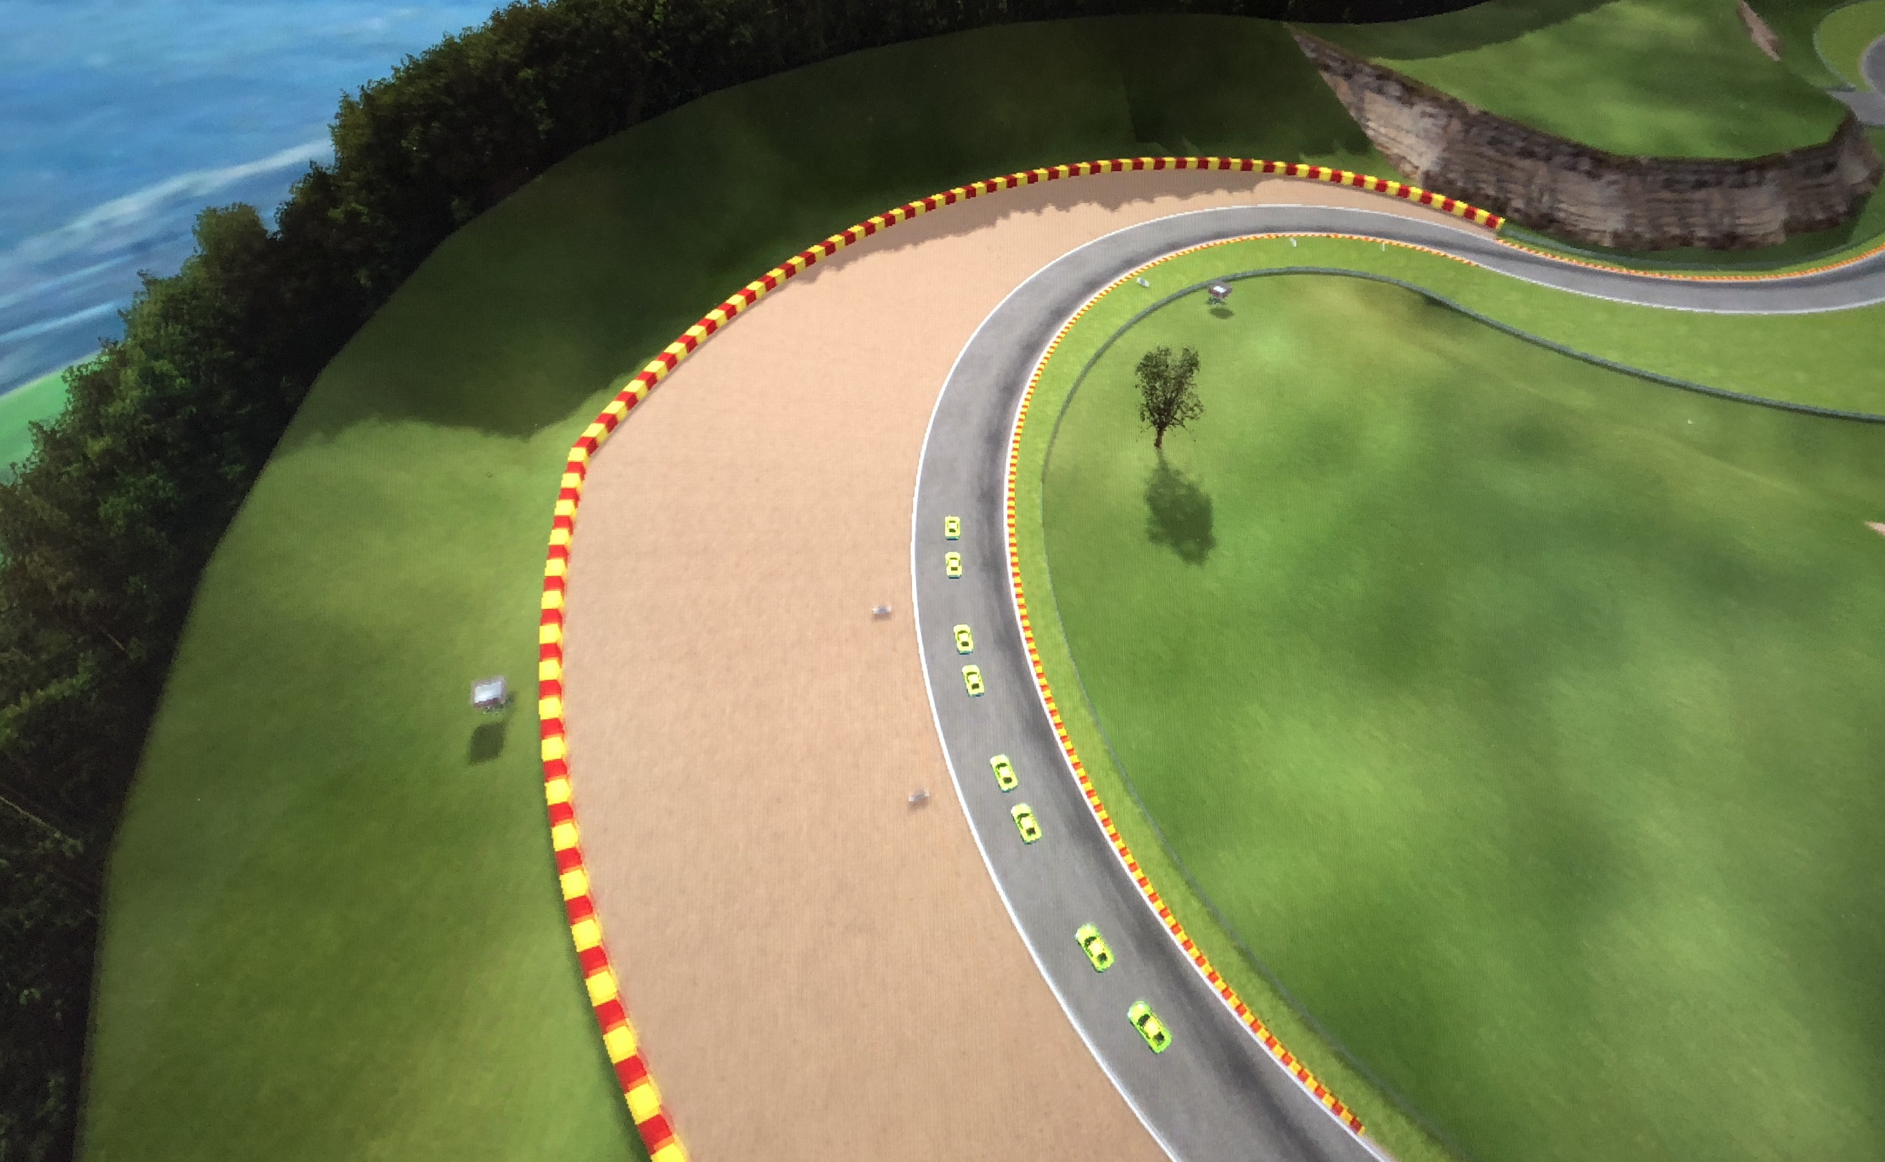
Results
Emergent Collective Behaviour

